Slide 1

Secure Pipeline For Machine Learning With Homomorphic Encryption
Group Members
Muhammad Abubakar (19P-0027)
Muhammad Javed Iqbal (19P-0088)
Tahawar Ihsan (19P-0097)
Project Supervisor
Dr. Muhammad Amin

Slide 2

Introduction
Secure machine learning is a method that enables precise data analysis while preserving the security of individual data contributors.
Secure machine learning involves developing and implementing machine learning models that are resistant to attacks and ensure the confidentiality, integrity, and availability of the data and models used.

Slide 3
Problem Statement
Machine learning algorithms often require access to large datasets that may contain personal, financial, or medical information, which can be vulnerable to attacks by hackers, cybercriminals, or other malicious actors.

Slide 4



Security Techniques
Differential Privacy
Homomorphic Encryption
Federated Learning

Slide 5
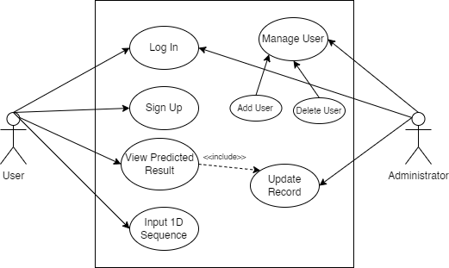
Use Case Diagram
Figure 1.1 : Use Case Diagram

Slide 6
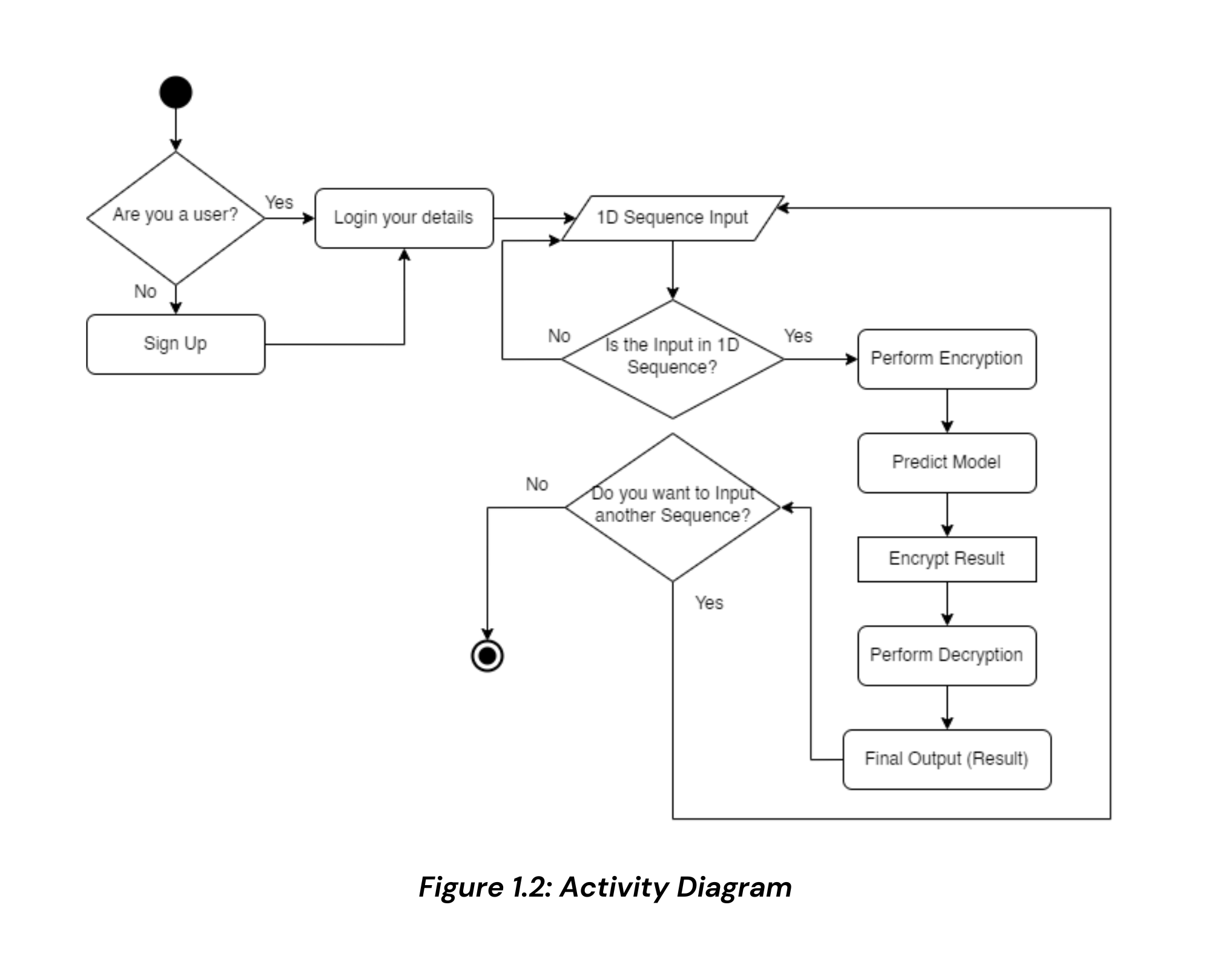
Activity Diagram

Slide 7
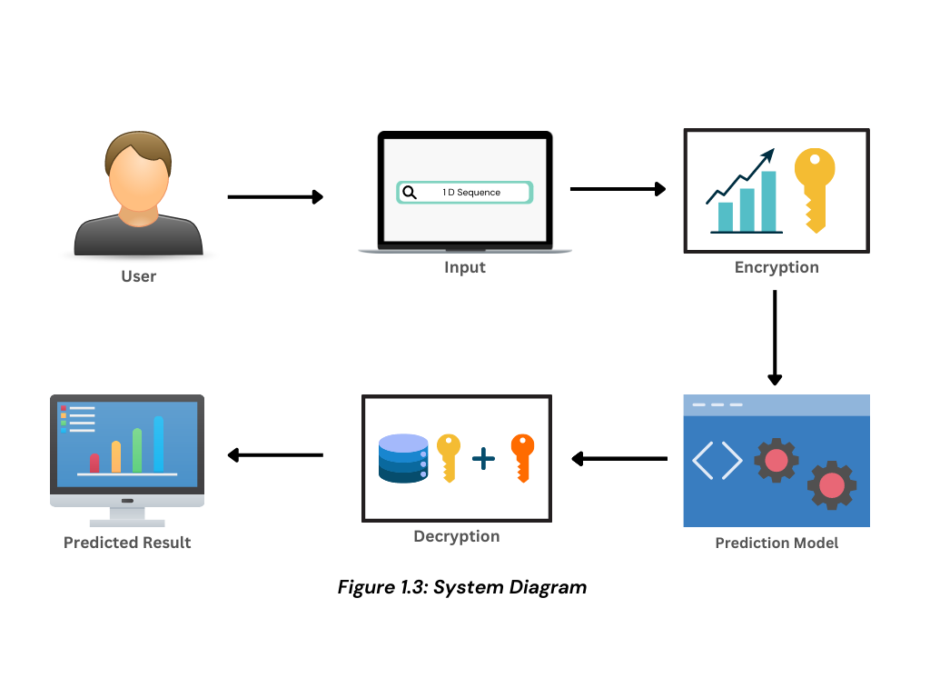
System Diagram

Slide 8

Objectives
Protecting sensitive data
Enhancing privacy
Improving security
Enabling more data sharing

Slide 9

Tools Used
TensorFlow
Jupyter notebook
Python
React JS
MongoDB

Slide 10
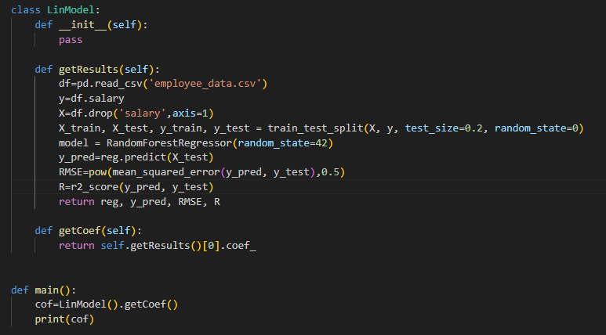
Model Initialization

Slide 11
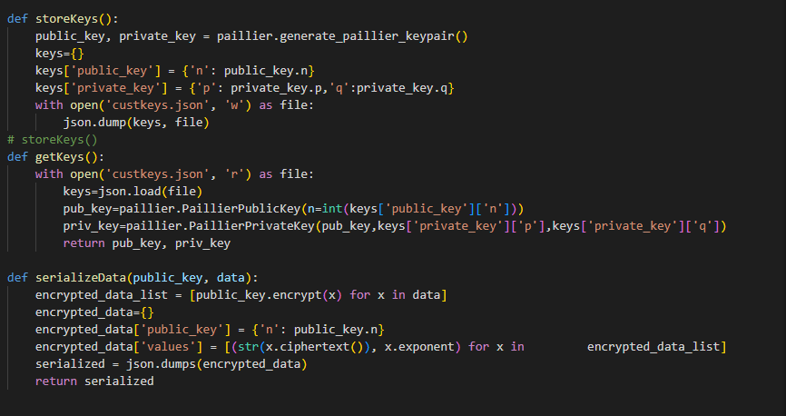
Key Generation

Slide 12
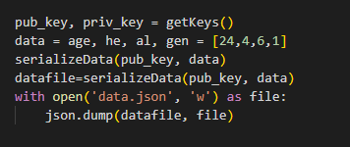
Storing Data in a Vector Form

Slide 13
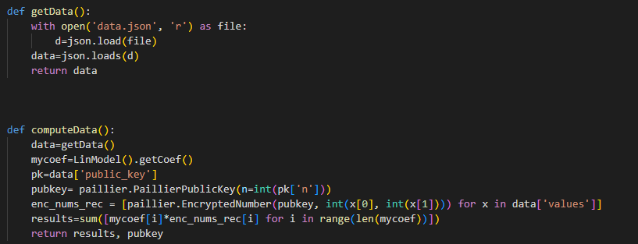
Computing & Forwarding Data

Slide 14
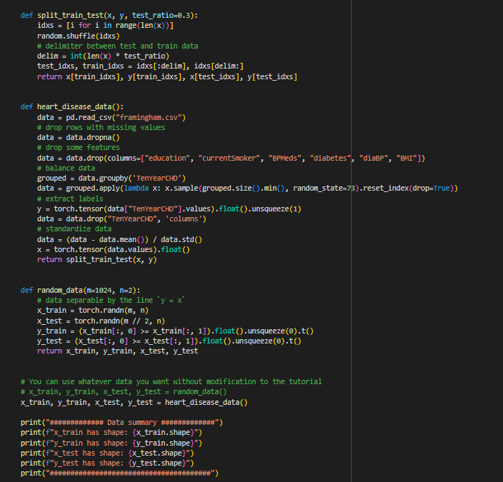
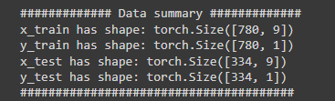

Slide 15
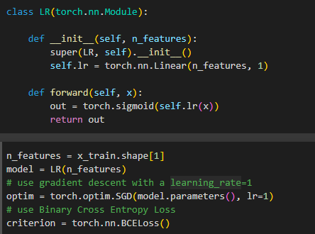
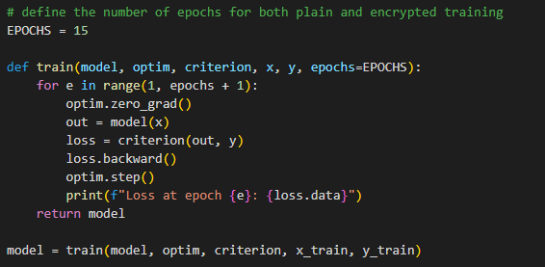
Training a Logistic Regression Model

Slide 16
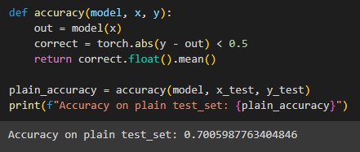

Slide 17
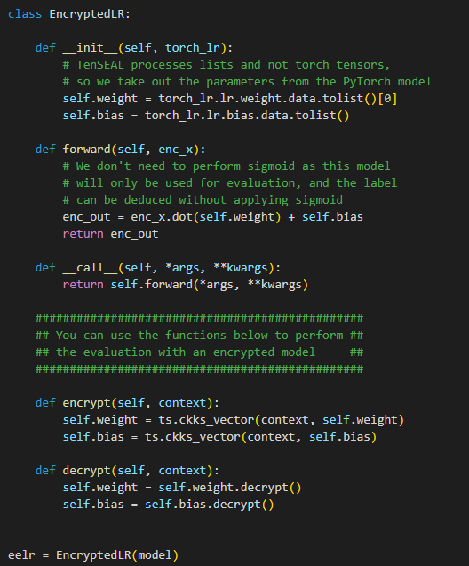
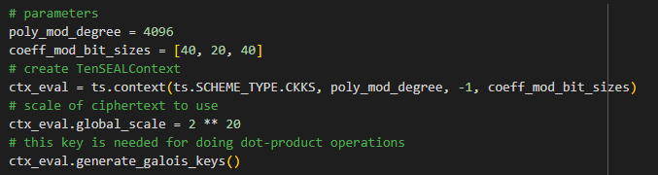

Slide 18
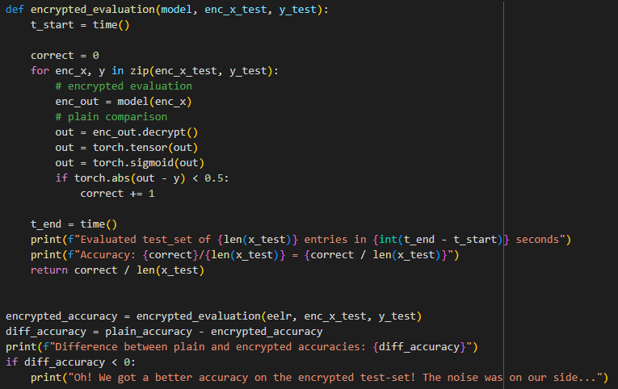

Slide 19
Link to the websites
https://secureml.netlify.app/
https://securepipelineformachinelearning.streamlit.app/

Slide 20
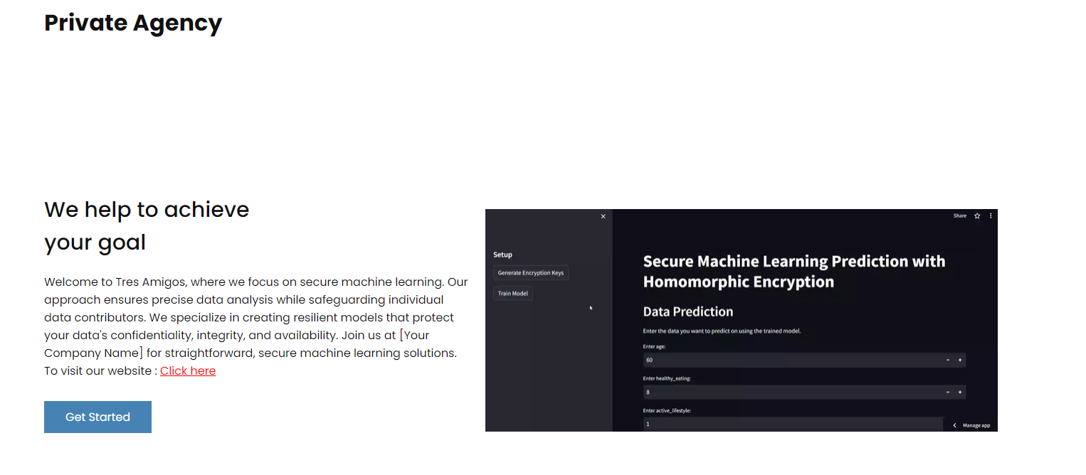
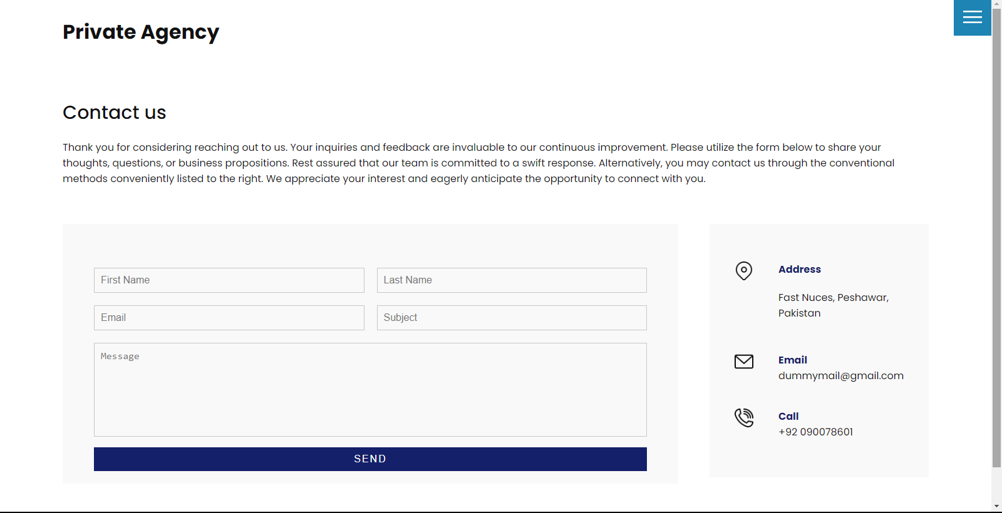

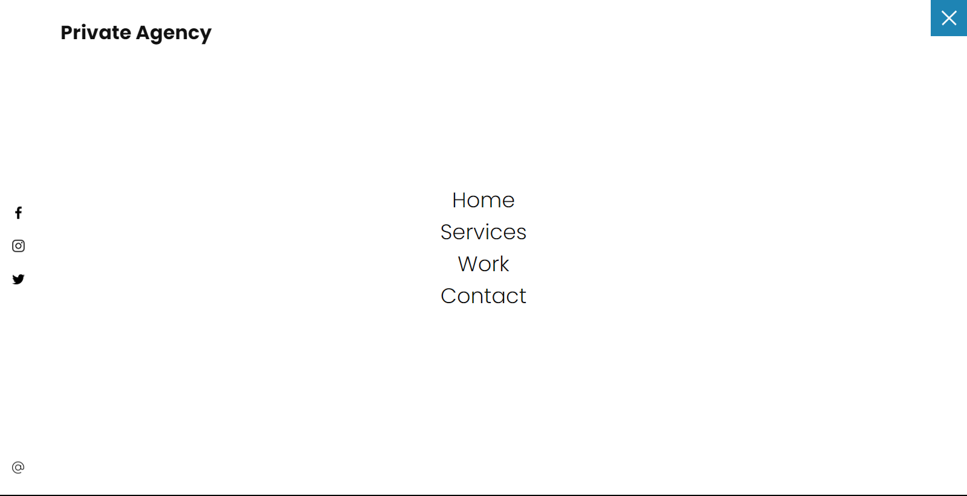
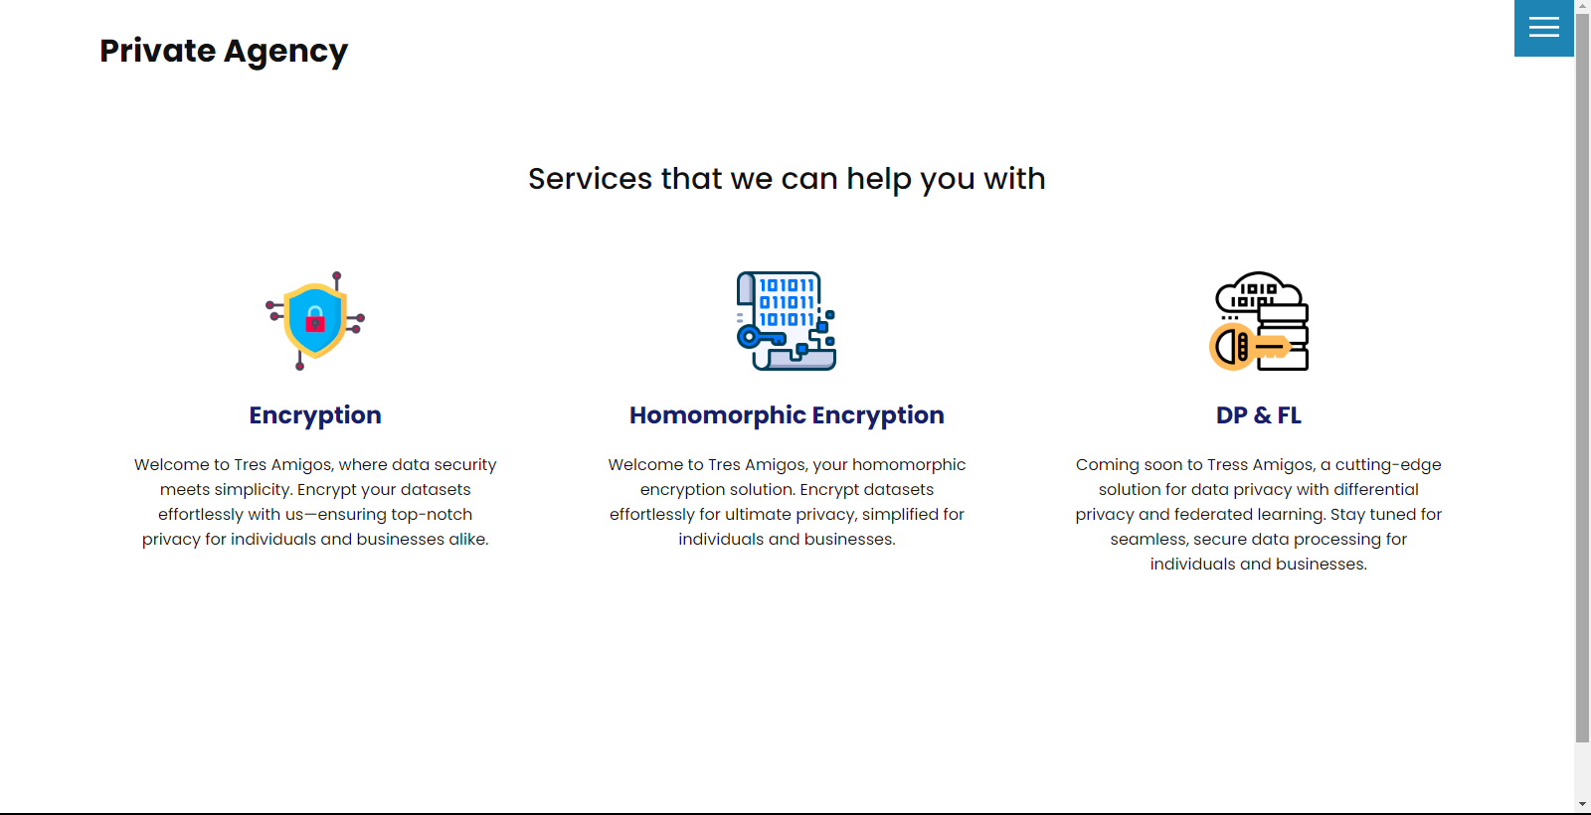

Slide 21
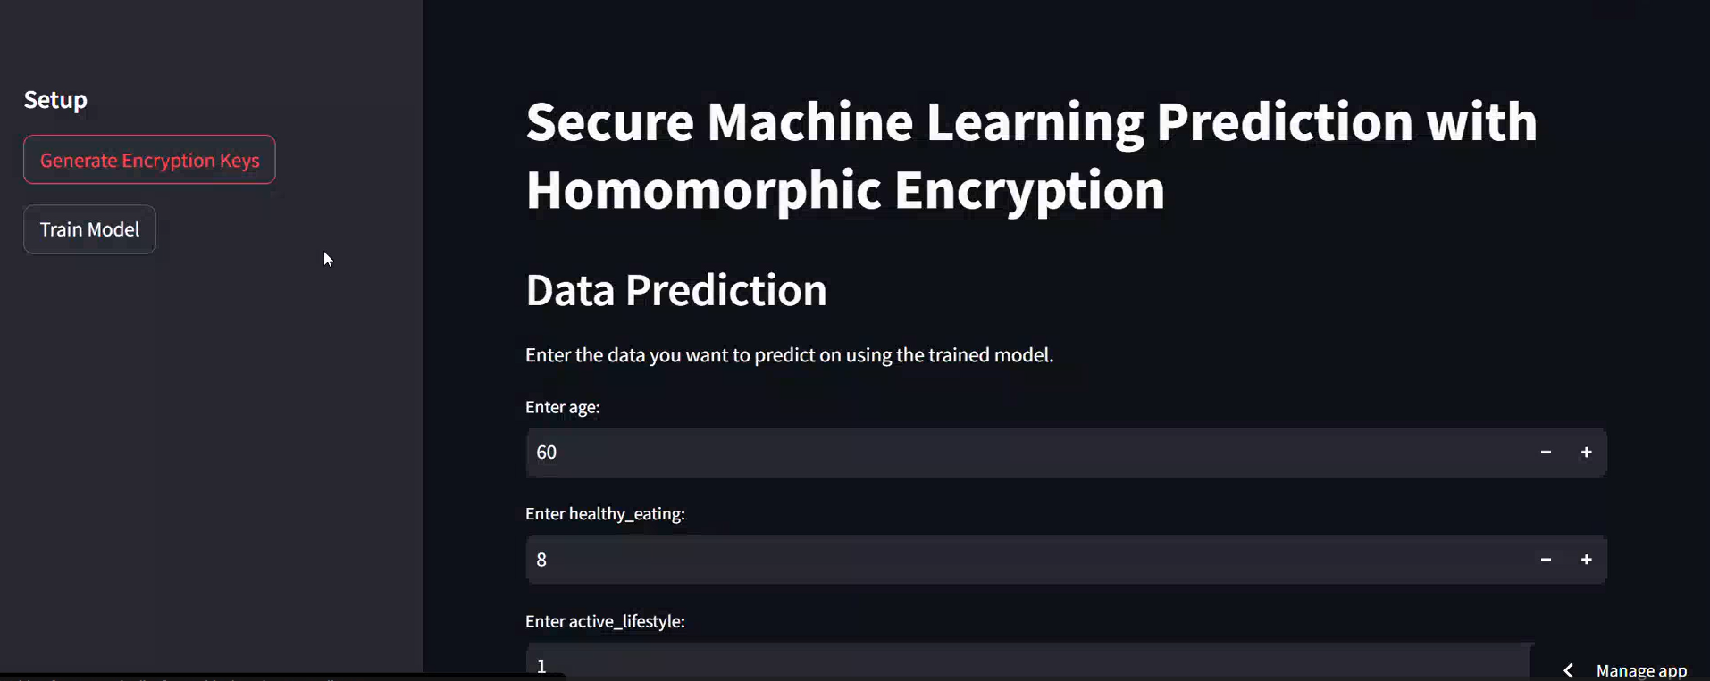
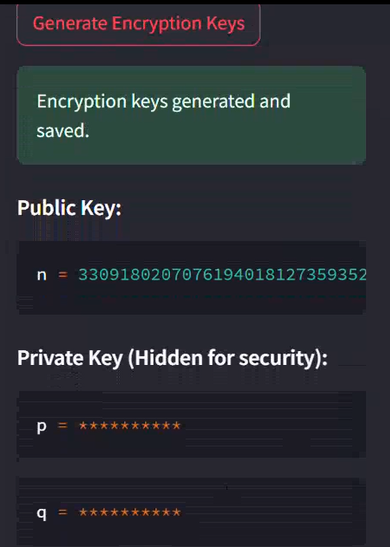
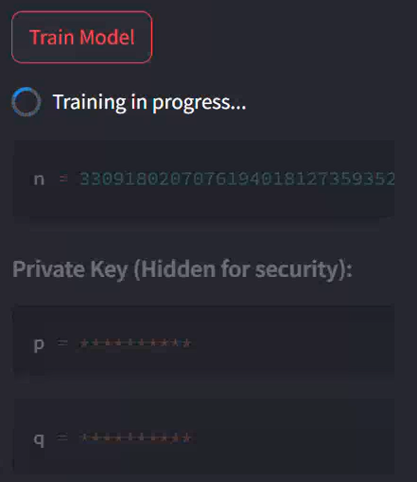


Slide 22
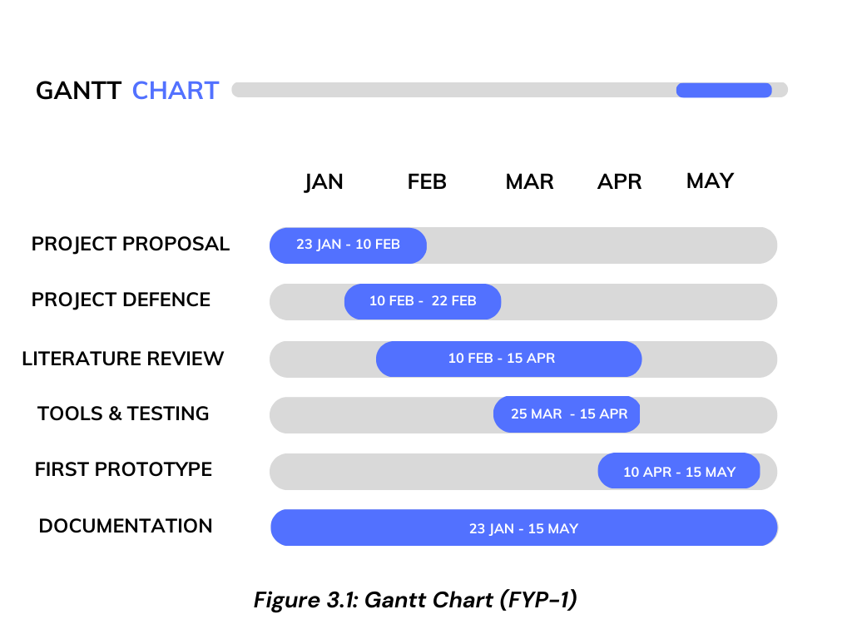

Slide 23
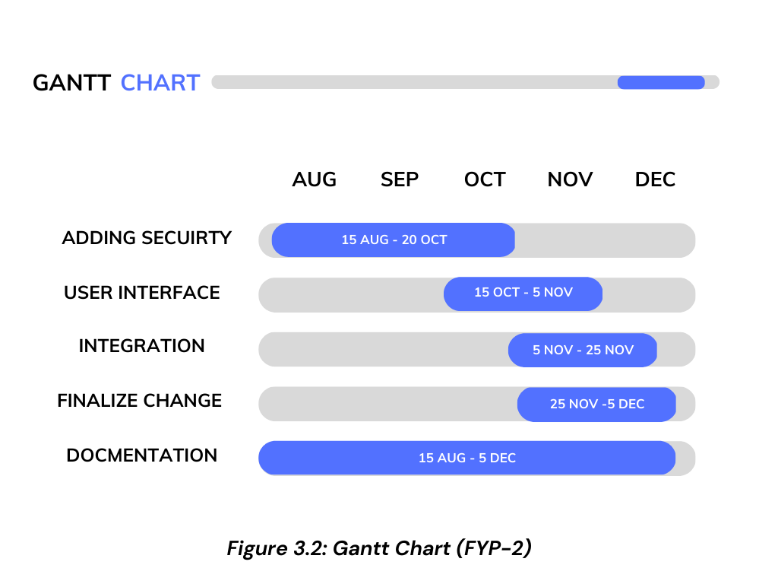

Slide 24
Team Work
Task Assigned To
Project Proposal Abubakar, Javed, Tahawar
Literature Review Tahawar
System Diagram Abubakar, Javed
UML Diagrams Abubakar, Javed, Tahawar
Tools Testing Abubakar, Javed, Tahawar
Documentation Abubakar, Javed
Front End Development Abubakar, Javed
Back End Development Abubakar, Tahawar
Code Javed, Tahawar

Slide 25
Thank you!

